Slide 1
Object Detection and Identification for Blind and Deaf People in Video Scene
Project Domain : Embedded & IOT
Team Members: Harika
Rupa Sree
Lebasini RR

Slide 2
Overview
This project investigates methods and procedures to construct an efficient system to assist blinds in their everyday life.
In particular, various technologies that can be utilized to build a wearable system are examined.
The machine vision and the communication component of the blind navigation and guidance is designed not only to search the surroundings environment but also to determine a safe.
This work highlights the importance and also provides the instructions to blinds for efficient navigation and safe guidance by incorporating object/pedestrian detection in real-time.

Slide 3
Abstract
This system consists of two main components: environment information acquisition and analysis and information representation.
The first component aims at capturing the environment by using a camera and analyzing it in order to detect the predefined obstacles for visually impaired and deaf people
While the second component when there is an obstacle to the right of the user; he or she feels strong frequent pulses on the right side through the haptic strap.
For the user, this leads to the perception of an obstacle to the right. The user can then avoid the obstacle by stepping left.
After stepping left, the pulses on the right side stop and the user perceives that there is no longer an obstacle on his or her right side

Slide 4
Problem Definition
Navigating modern streets are not easy for fully abled people especially in Indians cities, this makes it hundred time more harder for a blind person
Here we try to solve this problem to make it less harder for a blind person

Slide 5
Existing System
The common way for navigating of visionless person is using a walking stick cane or walking cane.
The walking cane is a simple and mechanical device dedicated to detect static obstacles on the ground, uneven surfaces, and holes via simple tactile-force feedback.
This device is light, portable but range limited and it is not usable for the protection from obstacles near to head area.
Another option that provides the best travel aid for the blind is the guide dogs. The disabled owner and his dog, the training and the relationship to the animal are the keys to success for this method.
The dog is able to detect and analyse complex situations: cross walks, stairs, potential danger, know paths and more.

Slide 6
Disadvantages
Walking sticks can only help to a level
Previous existing systems uses range finder sensor that can only detect obstacle in general not the type of obstacle
No audio feedback available

Slide 7
Proposed System
Our proposed visual substitution system is based on the identification of objects around the blind and deaf person.
We propose a system that recognize and locate 2D in the video.
This system should find the invariant characteristic of objects, provide the recognition and reduce the complexity of detection.
We propose a method based on object extraction and matching in video.
A comparison between query frame and database objects is made to detect object in each frame.
For each object detected an audio file containing the information about it is activate.

Slide 8
Advantages
Convolutional Neural Network is very advanced deep learning algorithm
Number of data set is high hence accuracy is also high
Uses simple USB camera for video capture
No 3D camera is used
cost effective

Slide 9
Literature survey 1
Title -Application of Image Processing for Inspection of Pill Production Process
Year – 2021
Author –Witsarut sriratana , Ruangsit apichitanon, Narin tammarug wattana ,Songchai weerathaw
Technique - inspection, image processing, pill, perfect, imperfect, distinguish
Drawback- Not a mobile system like proposed system

Slide 10
Literature survey 2
Title -Automatic Fault Detection of Multiple Targets in Railway Maintenance Based on Time-Scale Normalization
Year – 2020
Author - Shengfang Lu, Zhen Liu, Yuan Shen
Technique -China Railway High-Speed (CRH), fault detection, image alignment, multiple targets, time-scale normalization.
Drawback -Involves high level data processing need to use costly hardware

Slide 11
Literature survey 3
Title - Automated Visual Quality Inspection and Sorting
Year – 2019
Author - Aashay Sathe, Dr. Anjali Deshpande
Technique - Automation; biscuits; cookies; Digital image processing; quality; inspection, sorting
Drawback - Not a mobile system like proposed system

Slide 12
Literature survey 4
Title - Big data framework for rail inspection
Year – 2018
Author – Yunus santur , Mehmet karkose ,Erhan akin
Technique - Railway Inspection
Drawback - Very costly since rails stretch for kilometers. Need to fix so many cameras

Slide 13
Literature survey 5
Title - Automatic Fault Detection of Multiple Targets in Railway Maintenance Based on Time-Scale Normalization
Year – 2017
Author - Zhen Liu ,Yuan Shen, Shengfang Lu
Technique - China Railway High-Speed (CRH), fault detection, image alignment, multiple targets, time-scale normalization.
Drawback - Involves high level data processing need to use costly hardware

Slide 14
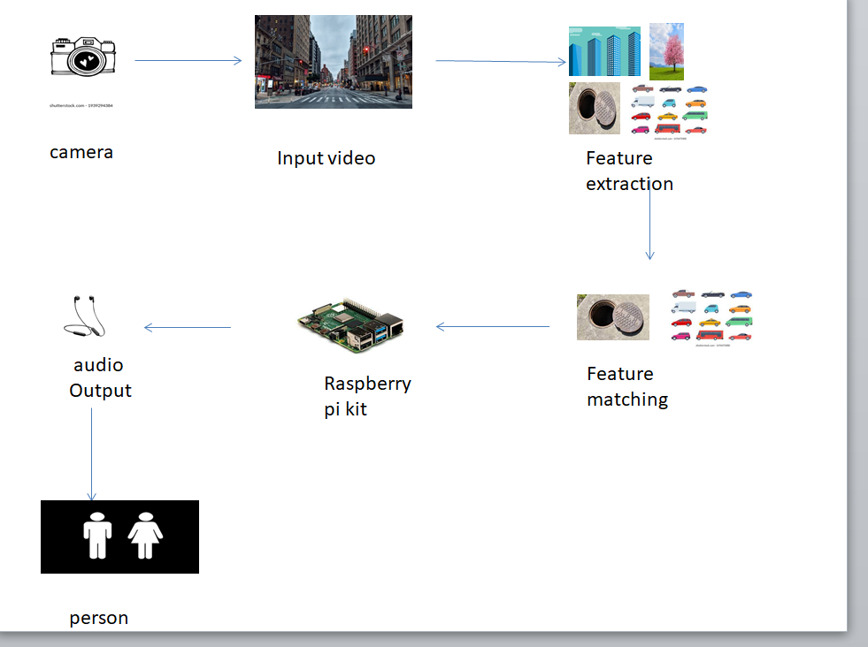
System Architecture

Slide 15
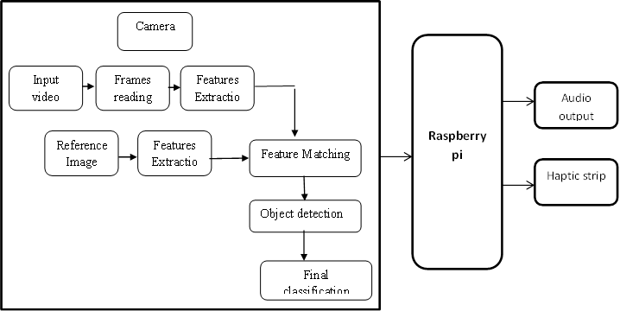
Block diagram

Slide 16
Feasibility Study
The Raspberry Pi is perfect for adaptive technology and it is able to display images or play videos.
Object detection can be made more faster by using a high end Single board computer with GPU.
The product does not require user to have extensive programming experience since it is aimed for the younger generation to learn about programming.
This microcomputer is useful for small business that run on a lower budget to use their product or to invent new technology that embeds the product.
The product is efficient and it provides an ethical alternative to small businesses.
This small card sized product i.e.; makes it easy to recycle and does not release as much carbon dioxide emissions into the environment

Slide 17
Cost benefit analysis
Cost benefit analysis : 40k

Slide 18
Hardware Requirement
Raspberry pi
Camera
Haptic strip

Slide 19
Software Tools
Raspberry pi OS: Raspbian stretch
Programming platform: python 3 IDLE
Programing language: python 3
Library: OpenCV

Slide 20
Future Work
We present a visual substitution system for blind people based on object recognition in video scene.
This system uses SIFTS key points extraction and features matching for object identification.
We devote the experimental part to test the application in order to detect some objects in some video scene with different conditions.
In this stage of works, we address the recognition of each object in the scene as an individual task, we do not consider the relationships between many objects.
Thus, in future works, we will consider this relationship for scene understanding or detecting everything that belongs to a given place or location.
Finally, in order to help bind people and to provide from the new technologies, a mobile application can be the best solution.

Slide 21
REFERENCES
[1] Auvray, M., Hanneton, S., and O’Regan, J. K., 2016. Learning to perceive with a visuo - auditory substitution system: Localisation and object recognition with ’The vOICe’. Perception, pp. 416–430.
[2] Durette, B., Louveton, N., Alleysson, D., and H´erault, J, 2020. Visuoauditory sensory substitution for mobility assistance: testing The VIBE. In Workshop on Computer Vision Applications for the Visually Impaired, Marseille, France.
[3] Hern´andez, A. F. R. et al, 2019. Computer Solutions on Sensory Substitution for Sensory Disabled People. In Proceedings of the 8th WSEAS International Conference on Computational Intelligence, Manmachine Systems and Cybernetics, pp. 134–138.
[4] Kammoun, S. et al, 2017. Navigation and space perception assistance for the visually impaired: The NAVIG project. In IRBM, Numro spcial ANR TECSAN, 33(2), pp.182–189.
[5]Tang, H., and Beebe, D. J., 2018. An oral tactile interface for blind navigation. IEEE Trans Neural Syst Rehabil Eng, pp. 116–123.

